Slide 1
RECURSIVE AND DYNAMIC PROGRAMMING
Presented to: Mr. Maseruka Benedicto
Computer Programming Course
By Group 7

Slide 2
GROUP 7 MEMBERS
NO. | NAME | REG. NUMBER | PROGRAM
1 | SSEBAKIJJE HOSEA | BU/UP/2024/0847 | AMI
2 | ETYANG JONATHAN | BU/UG/2024/2671 | APE
3 | KOBUSINGYE BETHLINE | BU/UG/2024/2602 | PTI
4 | GUDOI ALLAN | BU/UP/2024/4449 | WAR
5 | NYERO MARIA ASUMPTA | BU/UP/2024/1053 | WAR
6 | KAKURU OBADIAH | BU/UP/2024/1029 | WAR
7 | SEMBERA SHERINA TAPINESS | BU/UP/2024/5349 | MEB
8 | ADIPO HOPE | BU/UP/2024/0980 | MEB
9 | ESARAIT BRIAN | BU/UP/2024/5343 | MEB

Slide 3
INTRODUCTION TO MATLAB
MATLAB = Matrix Laboratory.
A high-performance language for technical computing.
Origin: Late 1970s by Cleve Moler.
Purpose: To provide easy access to matrix operations without needing Fortran.
Evolution: From a simple calculator to a commercial product (1984) with toolboxes, Simulink, and Live Editor.

Slide 4
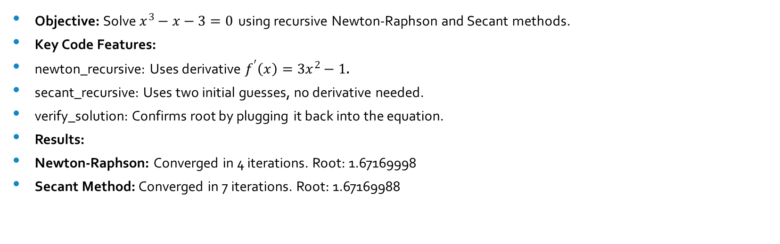
ASSIGNMENT 1 - RECURSIVE NUMERICAL METHODS
Objective: Solve $x^{3}−x−3=0$ using recursive Newton-Raphson and Secant methods.
Key Code Features:
newton_recursive: Uses derivative $f^{′}\left(x\right)=3x^{2}−1$.
secant_recursive: Uses two initial guesses, no derivative needed.
verify_solution: Confirms root by plugging it back into the equation.
Results:
Newton-Raphson: Converged in 4 iterations. Root: 1.67169998
Secant Method: Converged in 7 iterations. Root: 1.67169988

Slide 5
Reaction rate solver code;
clear
clc
% Purpose: Solves the reaction rate equation x^3 - x - 3 = 0 using two different numerical methods and verifies the solutions
function reaction_rate_solver()
% Display program header
fprintf('=== Reaction Rate Equation Solver ===\n');
fprintf('Solving: x^3 - x - 3 = 0\n\n');
tol = 1e-6; % Tolerance for convergence (stop when |f(x)| < tol)
max_iter = 100; % Maximum number of iterations to prevent infinite loops
% NEWTON-RAPHSON METHOD SECTION
fprintf('1. NEWTON-RAPHSON METHOD\n');
x0_newton = 1.5; % Initial guess for Newton-Raphson method
% Call recursive Newton-Raphson solver
root_newton = newton_recursive(x0_newton, tol, max_iter);
fprintf(' Root: %.8f\n', root_newton);

Slide 6
Rate solver code continued;
% SECANT METHOD SECTION
fprintf('\n2. SECANT METHOD\n');
x0_secant = 1.0; % First initial guess for Secant method
x1_secant = 2.0; % Second initial guess for Secant method
% Call recursive Secant solver
root_secant = secant_recursive(x0_secant, x1_secant, tol, max_iter);
fprintf(' Root: %.8f\n', root_secant);
% VERIFICATION SECTION
fprintf('\n3. VERIFICATION\n');
% Verify both solutions by plugging back into original equation
verify_solution(root_newton, 'Newton-Raphson');
verify_solution(root_secant, 'Secant');
fprintf('\n=== Solution Complete ===\n');
End
This is the main function that orchestrates the entire process. It sets the parameters, calls the recursive solvers, and verifies the results.

Slide 7
Newton recursive function code;
% NEWTON-RAPHSON RECURSIVE FUNCTION
% Inputs: x - current estimate of root
% tol - tolerance for convergence
% max_iter - maximum allowed iterations
% iter - current iteration count (optional, for internal use)
% Output: root - the found root of the equation
function root = newton_recursive(x, tol, max_iter, iter)
% If iter not provided, initialize to 1 (first call)
if nargin < 4
iter = 1;
end
% Safety check: prevent infinite recursion
if iter > max_iter
error('Newton: Maximum iterations reached');
end
% FUNCTION EVALUATION
f = x^3 - x - 3; % Evaluate f(x) = x^3 - x - 3
f_prime = 3*x^2 - 1; % Evaluate f'(x) = 3x^2 - 1 (derivative)

Slide 8
% CONVERGENCE CHECK
if abs(f) < tol
fprintf(' Converged in %d iterations', iter);
root = x; % Return current x as root if converged
return;
end
% NEWTON-RAPHSON UPDATE FORMULA
% x_new = x_old - f(x_old)/f'(x_old)
x_new = x - f / f_prime;
% Recursive call with updated estimate
root = newton_recursive(x_new, tol, max_iter, iter + 1);
End
This function recursively refines the root estimate using the function's derivative. It's efficient but requires the derivative to be known.
Secant recursive function code;
% SECANT RECURSIVE FUNCTION
% Inputs: x0, x1 - two previous estimates of root
% tol - tolerance for convergence
% max_iter - maximum allowed iterations
% iter - current iteration count (optional, for internal use)

Slide 9
Secant recursive function method continued;
% Output: root - the found root of the equation
function root = secant_recursive(x0, x1, tol, max_iter, iter)
% If iter not provided, initialize to 1 (first call)
if nargin < 5
iter = 1;
end
% Safety check: prevent infinite recursion
if iter > max_iter
error('Secant: Maximum iterations reached');
end
This function also recursively finds the root but uses two previous guesses instead of a derivative. It's more robust but can be slower than Newton-Raphson.
% FUNCTION EVALUATIONS
f0 = x0^3 - x0 - 3; % Evaluate f(x0)
f1 = x1^3 - x1 - 3; % Evaluate f(x1)
% CONVERGENCE CHECK
if abs(f1) < tol
fprintf(' Converged in %d iterations', iter);
root = x1; % Return current x1 as root if converged
return;
end

Slide 10
Rate……
% SECANT METHOD UPDATE FORMULA
% x2 = x1 - f(x1) * (x1 - x0) / (f(x1) - f(x0))
x2 = x1 - f1 * (x1 - x0) / (f1 - f0);
% Recursive call with updated estimates (shift x0, x1 forward)
root = secant_recursive(x1, x2, tol, max_iter, iter + 1);
end
% VERIFICATION FUNCTION
% Purpose: Verifies that the found root actually satisfies the equation
% Inputs: root - the root to verify
% method_name - name of the method used (for display purposes)
function verify_solution(root, method_name)
% Plug the root back into the original equation
f_val = root^3 - root - 3;
% Display result: should be very close to 0 if root is accurate
fprintf(' %s: f(%.8f) = %.2e\n', method_name, root, f_val);end
% This line actually runs the solver when the script is executed
reaction_rate_solver();
Results:
Newton-Raphson: Converged in 4 iterations. Root: 1.67169998
Secant Method: Converged in 7 iterations. Root: 1.67169988

Slide 11
Assignment 2 - Recursive vs. Dynamic Programming
Objective: Compare performance of Recursive and DP approaches for:
Fibonacci Sequence
0/1 Knapsack Problem

Slide 12
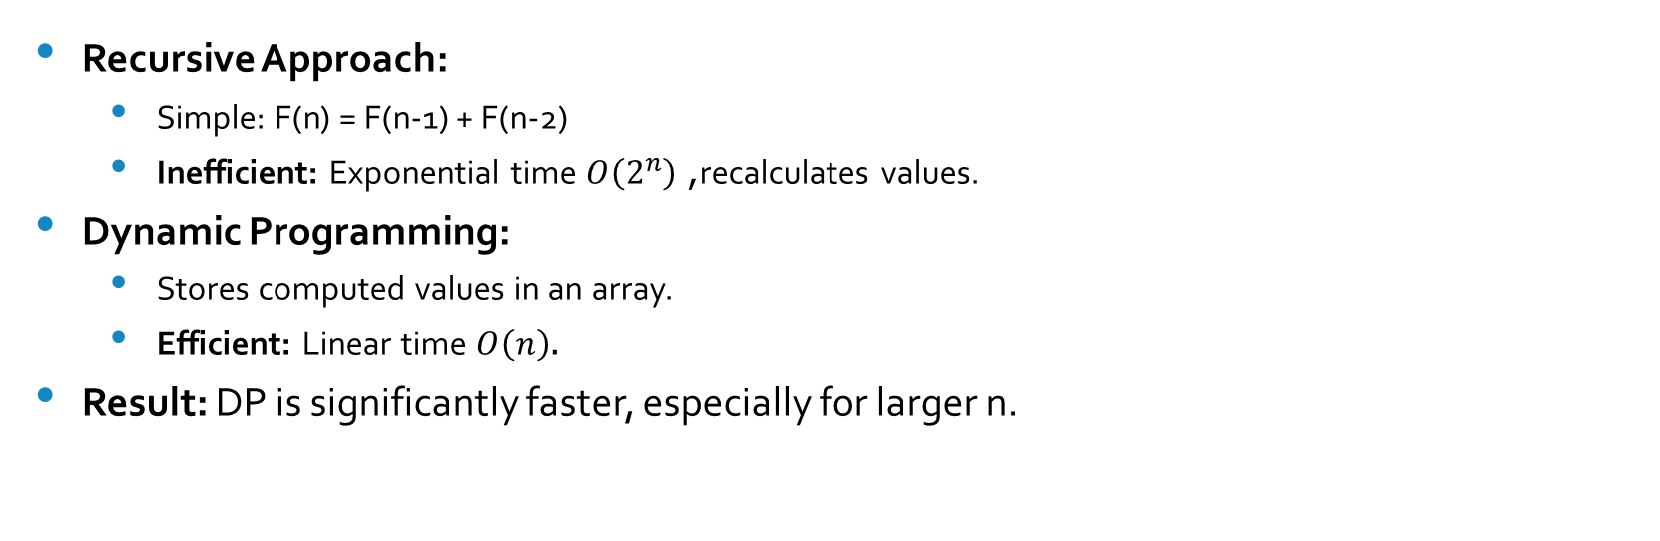
FIBONACCI SEQUENCE COMPARISON
Recursive Approach:
Simple: F(n) = F(n-1) + F(n-2)
Inefficient: Exponential time $O\left(2^{n}\right)$, recalculates values.
Dynamic Programming:
Stores computed values in an array.
Efficient: Linear time $O\left(n\right)$.
Result: DP is significantly faster, especially for larger n.

Slide 13
Fibionacci code implementation.
%Comparison: Recursive(rec) vs Dynamic Programming(dp)
clear;
clc;
%Fibonacci Functions
% Recursive Fibonacci - exponential time complexity O(2^n)
% Repeatedly calculates same values multiple times
function result = fib_rec(n)
if n <= 2
result = 1;
else
result = fib_rec(n-1) + fib_rec(n-2);
end
end
% Stores previously computed values to avoid redundant calculations
function result = fib_dp(n)
if n <= 2
result = 1;
return;
end

Slide 14
Fibinacci code implementation continued;
fib = [1, 1, zeros(1, n-2)]; % Initialize array to store computed values
for i = 3:n
fib(i) = fib(i-1) + fib(i-2); % Build solution bottom-up
end
result = fib(n);
End
For the Pure recursive approach; Notice how it calls itself twice. This leads to an exponential number of repeated calculations, making it very slow for large n
And for the Dynamic Programming approach. It uses an array (fib) to store previously computed numbers. This "bottom-up" method ensures each value is calculated only once, resulting in linear time complexity.

Slide 15
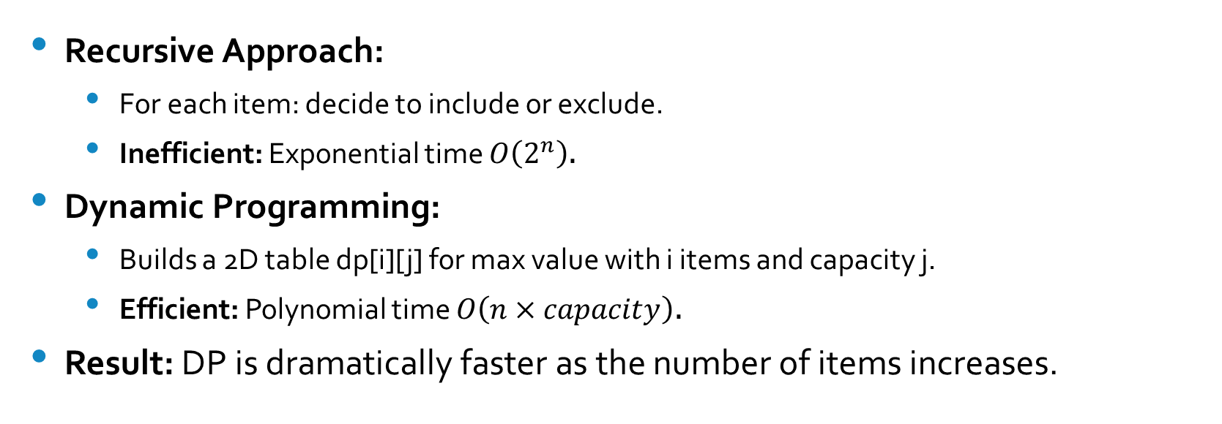
KNAPSACK PROBLEM COMPARISON
Recursive Approach:
For each item: decide to include or exclude.
Inefficient: Exponential time $O\left(2^{n}\right)$.
Dynamic Programming:
Builds a 2D table dp[i][j] for max value with i items and capacity j.
Efficient: Polynomial time $O\left(n×capacity\right)$.
Result: DP is dramatically faster as the number of items increases.

Slide 16
Knapsack code implementation;
% Knapsack Functions
% For each item, we have two choices: include or exclude
function max_val = ks_rec(w, v, cap, n)
if n == 0 || cap == 0
max_val = 0;
elseif w(n) > cap
max_val = ks_rec(w, v, cap, n-1); % Cannot include current item
else
include = v(n) + ks_rec(w, v, cap-w(n), n-1); % Include current item
exclude = ks_rec(w, v, cap, n-1); % Exclude current item
max_val = max(include, exclude); % Take better option
end
end
% Uses 2D table to store solutions to subproblems
function max_val = ks_dp(w, v, cap)
n = length(w);
dp = zeros(n+1, cap+1); % DP table: dp[i][j] = max value with first i items and capacity j

Slide 17
Knapsack code implementation continued;
for i = 1:n
for j = 0:cap
if w(i) <= j
% Max of excluding or including current item
dp(i+1, j+1) = max(dp(i, j+1), v(i) + dp(i, j+1-w(i)));
else
% Cannot include current item
dp(i+1, j+1) = dp(i, j+1);
end
end
end
max_val = dp(n+1, cap+1);
end
Recursive approach; For each item, it explores both possibilities (including or excluding the item), leading to an exponential number of function calls. Highly inefficient for many items.
Dynamic Programming approach; It builds a 2D table (dp) where each cell stores the solution to a subproblem. By filling the table iteratively, it avoids recomputation, making it highly efficient.

Slide 18
Perfomance comparison and testing code
% Test and Compare
fprintf('Simple Recursive vs Dynamic Programming Comparison\n\n');
% Test parameters
fib_test = [10, 15, 20, 25, 30]; % Fibonacci numbers to compute
ks_test = [5, 10, 15, 20]; % Number of items for knapsack
% Initialize arrays to store timing results
fib_rec_time = zeros(size(fib_test));
fib_dp_time = zeros(size(fib_test));
ks_rec_time = zeros(size(ks_test));
ks_dp_time = zeros(size(ks_test));

Slide 19
Fibionachi test
% Fibonacci Tests
fprintf('FIBONACCI:\n');
fprintf('n\tRecursive\tDP\t\tSpeedup\n');
for i = 1:length(fib_test)
n = fib_test(i);
% Recursive timing
tic; fib_rec(n); t1 = toc;
% Dynamic Programming timing
tic; fib_dp(n); t2 = toc;
fib_rec_time(i) = t1;
fib_dp_time(i) = t2;
fprintf('%d\t%.4fs\t%.4fs\t%.0fx\n', n, t1, t2, t1/t2);
end

Slide 20
Knapsack tests;
% Knapsack Tests
fprintf('\nKNAPSACK:\n');
fprintf('Items\tRecursive\tDP\t\tSpeedup\n');
for i = 1:length(ks_test)
n = ks_test(i);
% Generate random weights and values
w = randi([1, 15], 1, n); % Random weights between 1-15
v = randi([5, 30], 1, n); % Random values between 5-30
cap = 30; % Fixed capacity
% Recursive timing
tic; ks_rec(w, v, cap, n); t1 = toc;
% Dynamic Programming
tic; ks_dp(w, v, cap); t2 = toc;
ks_rec_time(i) = t1;
ks_dp_time(i) = t2;
fprintf('%d\t%.4fs\t%.4fs\t%.0fx\n', n, t1, t2, t1/t2);
end

Slide 21
% Fibonacci plot
figure;
plot(fib_test, fib_rec_time, 'ro-', 'LineWidth', 2); hold on;
plot(fib_test, fib_dp_time, 'bd-', 'LineWidth', 2);
xlabel('Fibonacci Number (n)');
ylabel('Time (seconds)');
title('Fibonacci: Recursive vs DP');
legend('Recursive', 'Dynamic Programming');
grid on;
% Knapsack plot
figure;
plot(ks_test, ks_rec_time, 'ro-', 'LineWidth', 2); hold on;
plot(ks_test, ks_dp_time, 'bd-', 'LineWidth', 2);
xlabel('Number of Items');
ylabel('Time (seconds)');
title('Knapsack: Recursive vs DP');
legend('Recursive', 'Dynamic Programming');
grid on;

Slide 22
%Comparison: Recursive(rec) vs Dynamic Programming(dp)
clear;
clc;
%Fibonacci Functions
% Recursive Fibonacci - exponential time complexity O(2^n)
% Repeatedly calculates same values multiple times
function result = fib_rec(n)
if n <= 2
result = 1;
else
result = fib_rec(n-1) + fib_rec(n-2);
end
end
% Stores previously computed values to avoid redundant calculations
function result = fib_dp(n)
if n <= 2
result = 1;
return;
end

Slide 23
fib = [1, 1, zeros(1, n-2)]; % Initialize array to store computed values
for i = 3:n
fib(i) = fib(i-1) + fib(i-2); % Build solution bottom-up
end
result = fib(n);
end
% Knapsack Functions
% For each item, we have two choices: include or exclude
function max_val = ks_rec(w, v, cap, n)
if n == 0 || cap == 0
max_val = 0;
elseif w(n) > cap
max_val = ks_rec(w, v, cap, n-1); % Cannot include current item
else
include = v(n) + ks_rec(w, v, cap-w(n), n-1); % Include current item
exclude = ks_rec(w, v, cap, n-1); % Exclude current item
max_val = max(include, exclude); % Take better option
end
end

Slide 24
% Uses 2D table to store solutions to subproblems
function max_val = ks_dp(w, v, cap)
n = length(w);
dp = zeros(n+1, cap+1); % DP table: dp[i][j] = max value with first i items and capacity j
for i = 1:n
for j = 0:cap
if w(i) <= j
% Max of excluding or including current item
dp(i+1, j+1) = max(dp(i, j+1), v(i) + dp(i, j+1-w(i)));
else
% Cannot include current item
dp(i+1, j+1) = dp(i, j+1);
end
end
end
max_val = dp(n+1, cap+1);
end
% Test and Compare
fprintf('Simple Recursive vs Dynamic Programming Comparison\n\n');

Slide 25
% Test parameters
fib_test = [10, 15, 20, 25, 30]; % Fibonacci numbers to compute
ks_test = [5, 10, 15, 20]; % Number of items for knapsack
% Initialize arrays to store timing results
fib_rec_time = zeros(size(fib_test));
fib_dp_time = zeros(size(fib_test));
ks_rec_time = zeros(size(ks_test));
ks_dp_time = zeros(size(ks_test));
% Fibonacci Tests
fprintf('FIBONACCI:\n');
fprintf('n\tRecursive\tDP\t\tSpeedup\n');
for i = 1:length(fib_test)
n = fib_test(i);
% Recursive timing
tic; fib_rec(n); t1 = toc;
% Dynamic Programming timing
tic; fib_dp(n); t2 = toc;

Slide 26
fib_rec_time(i) = t1;
fib_dp_time(i) = t2;
fprintf('%d\t%.4fs\t%.4fs\t%.0fx\n', n, t1, t2, t1/t2);
end
% Knapsack Tests
fprintf('\nKNAPSACK:\n');
fprintf('Items\tRecursive\tDP\t\tSpeedup\n');
for i = 1:length(ks_test)
n = ks_test(i);
% Generate random weights and values
w = randi([1, 15], 1, n); % Random weights between 1-15
v = randi([5, 30], 1, n); % Random values between 5-30
cap = 30; % Fixed capacity
% Recursive timing
tic; ks_rec(w, v, cap, n); t1 = toc;

Slide 27
% Dynamic Programming
tic; ks_dp(w, v, cap); t2 = toc;
ks_rec_time(i) = t1;
ks_dp_time(i) = t2;
fprintf('%d\t%.4fs\t%.4fs\t%.0fx\n', n, t1, t2, t1/t2);
end
% Fibonacci plot
figure;
plot(fib_test, fib_rec_time, 'ro-', 'LineWidth', 2); hold on;
plot(fib_test, fib_dp_time, 'bd-', 'LineWidth', 2);
xlabel('Fibonacci Number (n)');
ylabel('Time (seconds)');
title('Fibonacci: Recursive vs DP');
legend('Recursive', 'Dynamic Programming');
grid on;

Slide 28
% Knapsack plot
figure;
plot(ks_test, ks_rec_time, 'ro-', 'LineWidth', 2); hold on;
plot(ks_test, ks_dp_time, 'bd-', 'LineWidth', 2);
xlabel('Number of Items');
ylabel('Time (seconds)');
title('Knapsack: Recursive vs DP');
legend('Recursive', 'Dynamic Programming');
grid on;
This code measures the execution time for both recursive and DP methods across different input sizes. The speedup factor clearly demonstrates the massive efficiency gain of DP.
Graphs:
Graph 1: Fibonacci - Shows recursive time exploding while DP remains fast.
Graph 2: Knapsack - Shows a similar dramatic performance difference.

Slide 29
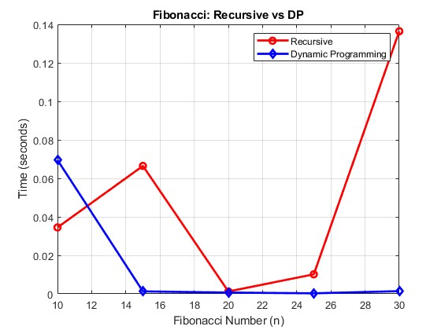
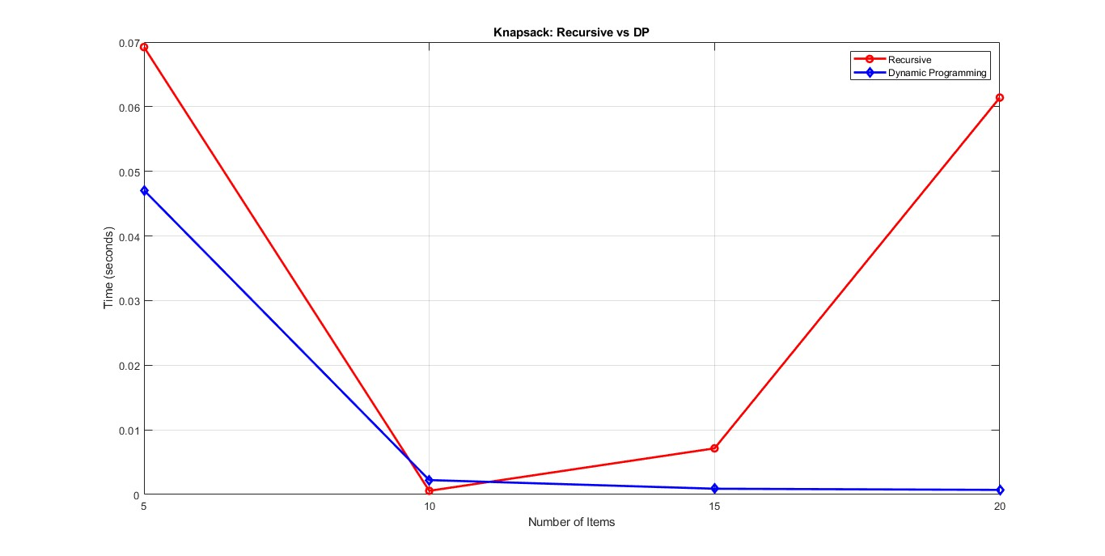
Fibonacci
Observation: Recursive time grows rapidly; DP time remains near zero.
Knapsack
Observation: Recursive time spikes with more items; DP time grows slowly.

Slide 30
CONCLUSION & LEARNING EXPERIENCE
Gained practical understanding of MATLAB programming.
Reinforced concepts from modules.
Key takeaway: Dynamic Programming optimizes solutions by storing results of subproblems, avoiding redundant calculations, and drastically reducing computation time compared to naive recursion.

Slide 31
REFERENCES
MATLAB Official Documentation
Computer Programming Lecture Notes
YouTube tutorials on:
Fibonacci Sequence
Recursive Functions
Dynamic Programming
Knapsack Problem

